Slide 1
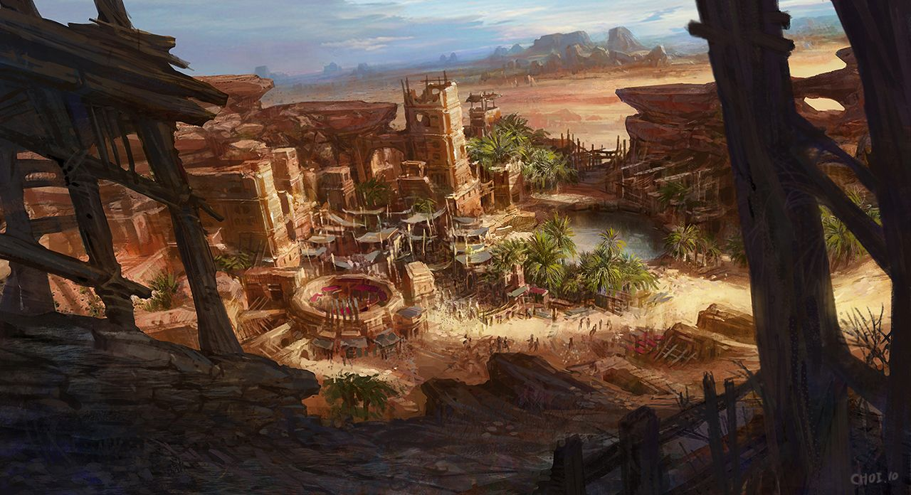
The Unfinished Tome Web Application
By Dr. James Monks

Slide 2
Introduction
The Unfinished Tome is a LARP game run by the UoN RPGSoc.
Players create characters with stats such as HP, MP and AP.
Players can buy skills for their characters which can improve their stats or give them special abilities.

Slide 3
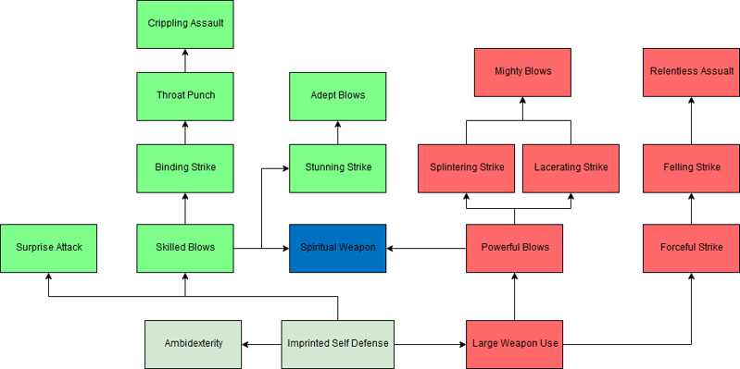
Skill Tree example

Slide 4
Planning
Planning steps included:
Making a Jira board
Creating an entity relationship diagram
Making wireframe diagrams for webpages

Slide 5
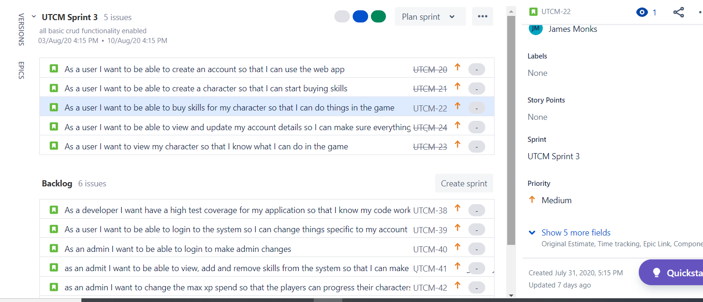
Jira backlog

Slide 6
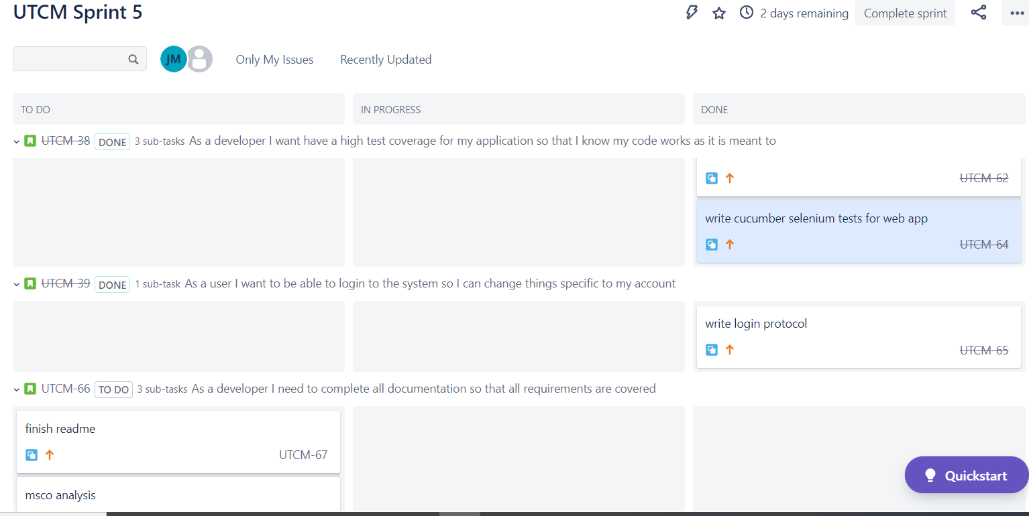
Jira Sprint

Slide 7
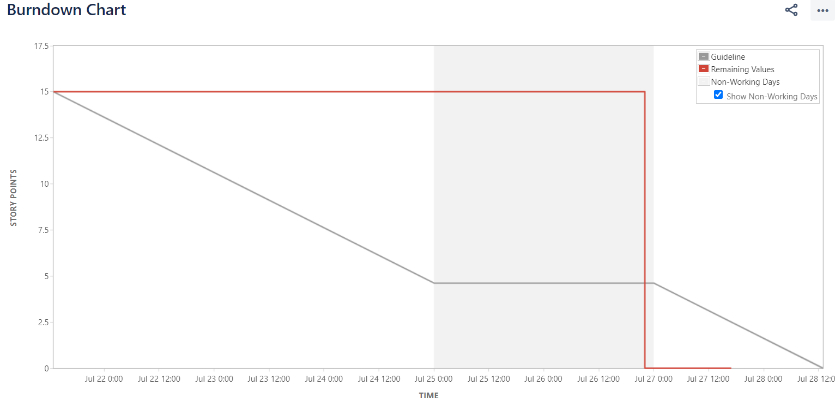
Sprint 1

Slide 8
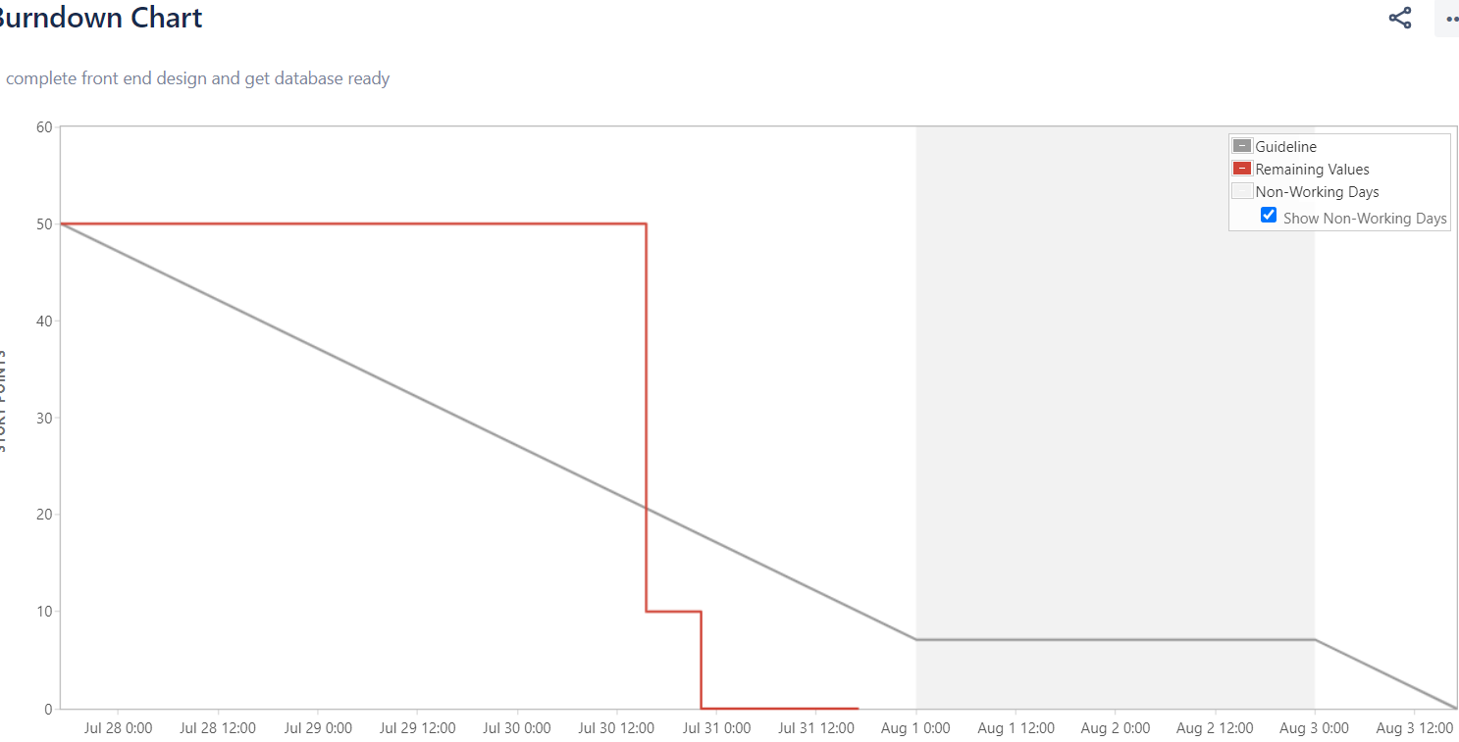
Sprint 2

Slide 9
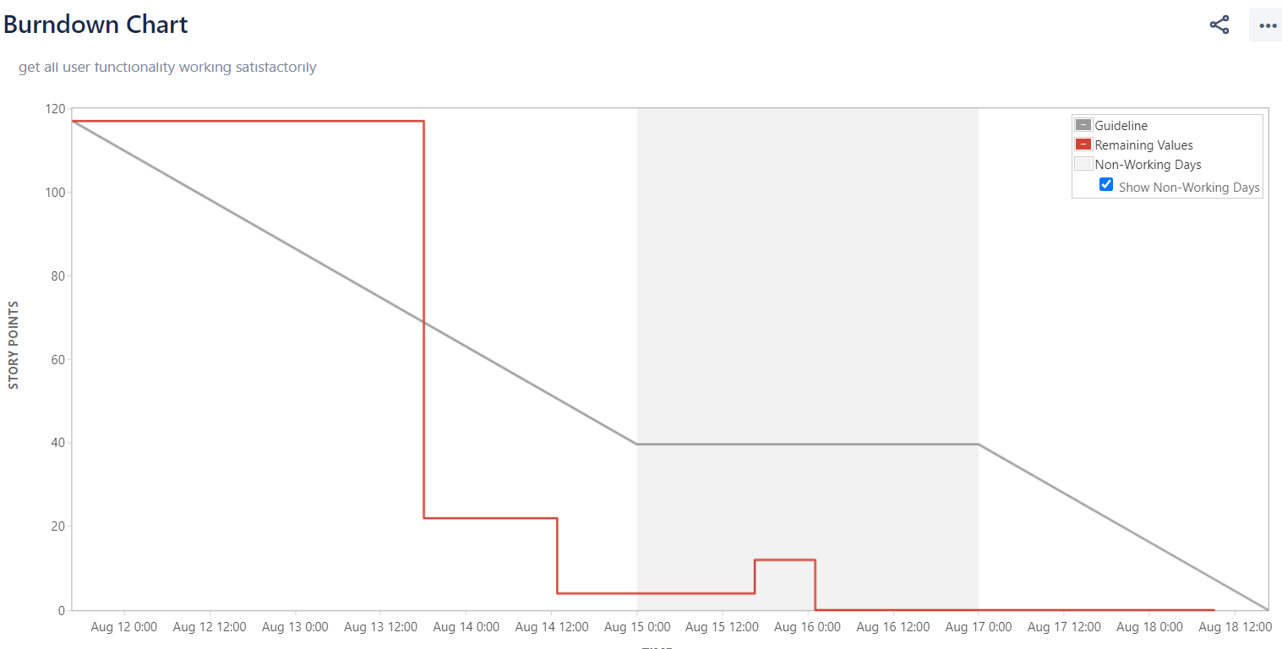
Sprint 4

Slide 10
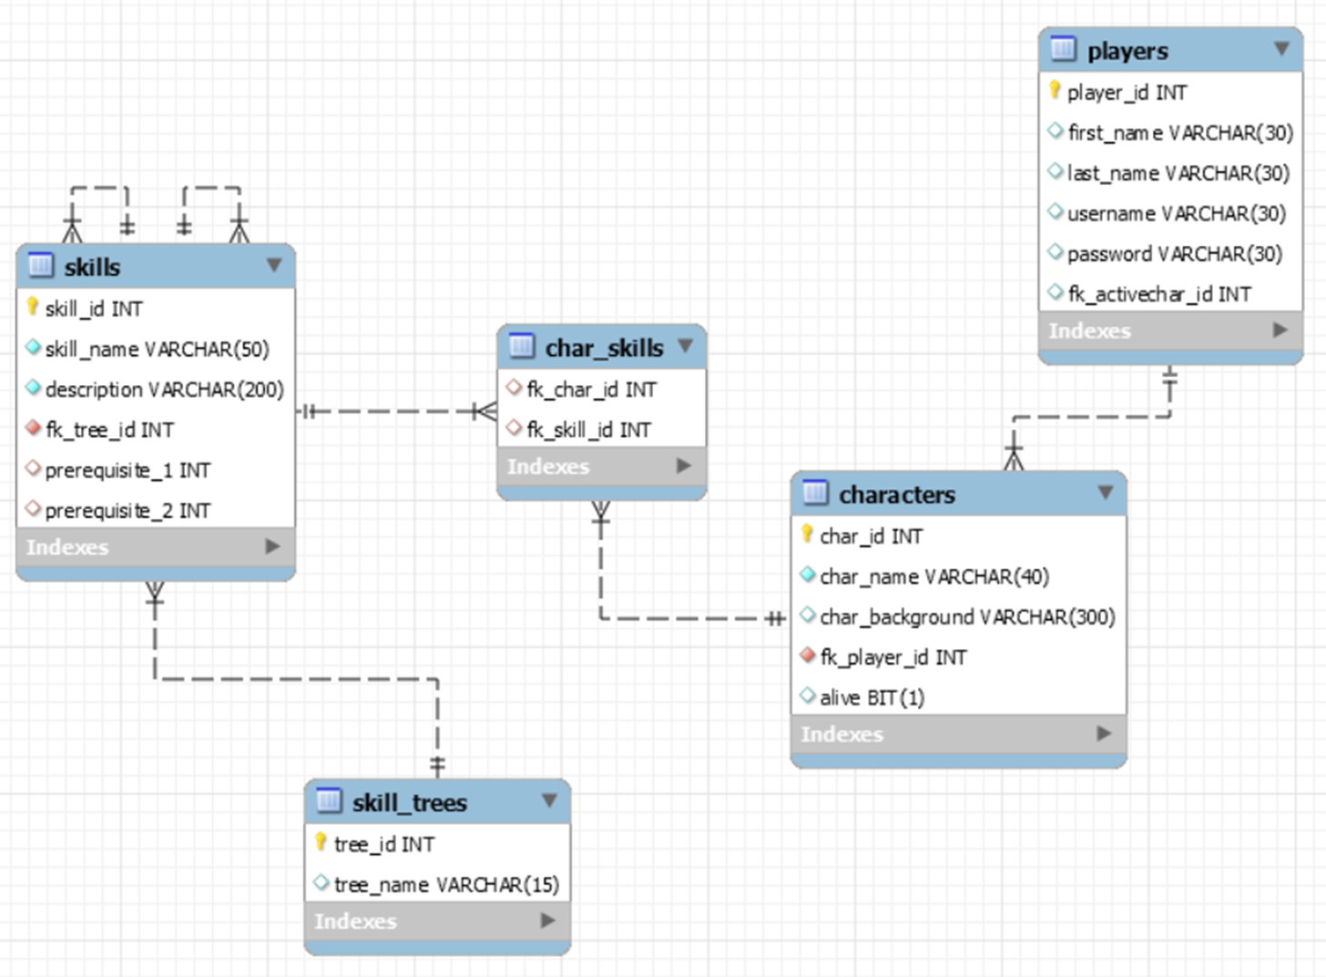
Entity Relationship diagram

Slide 11
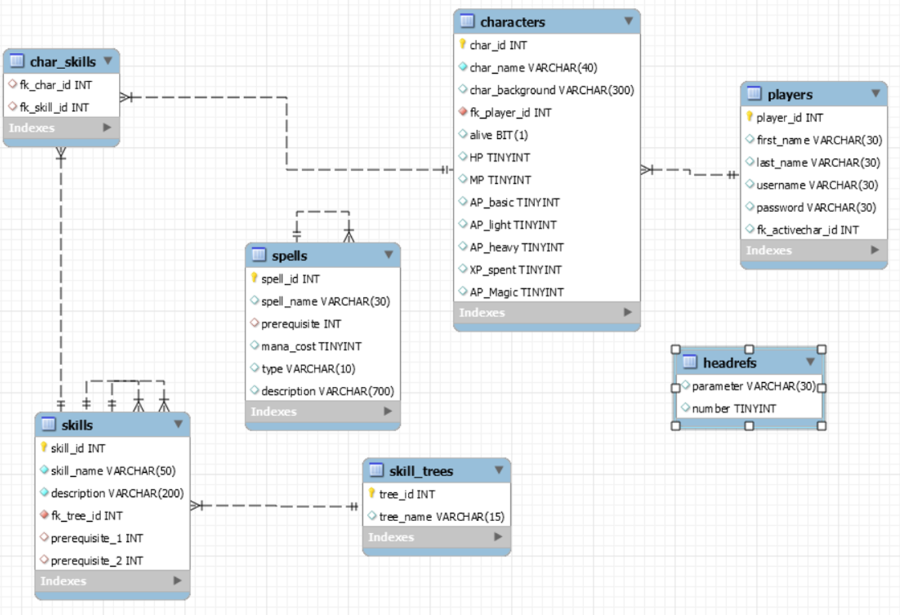
Entity Relationship diagram

Slide 12
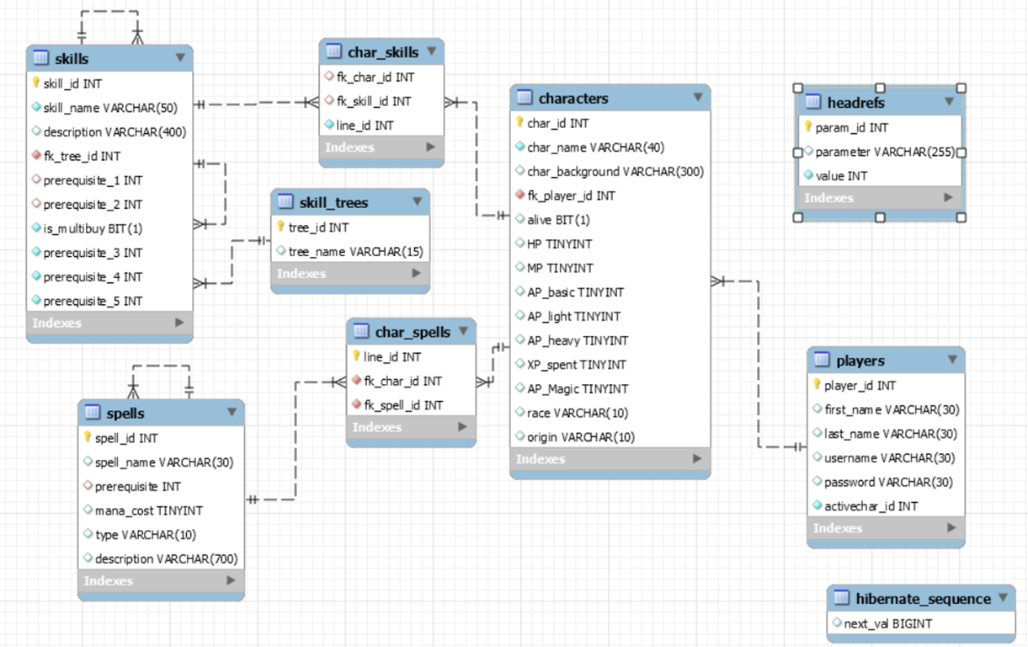
Entity Relationship diagram

Slide 13
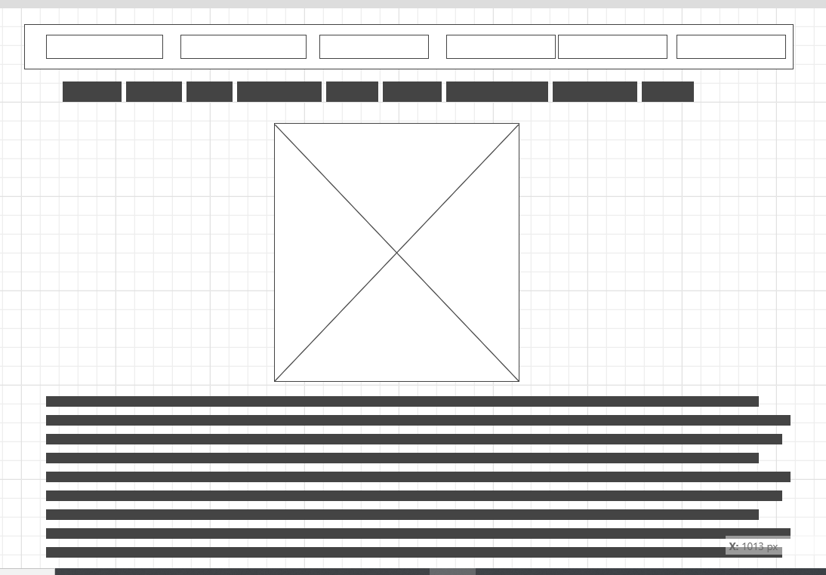
Wireframe diagrams – Home page

Slide 14
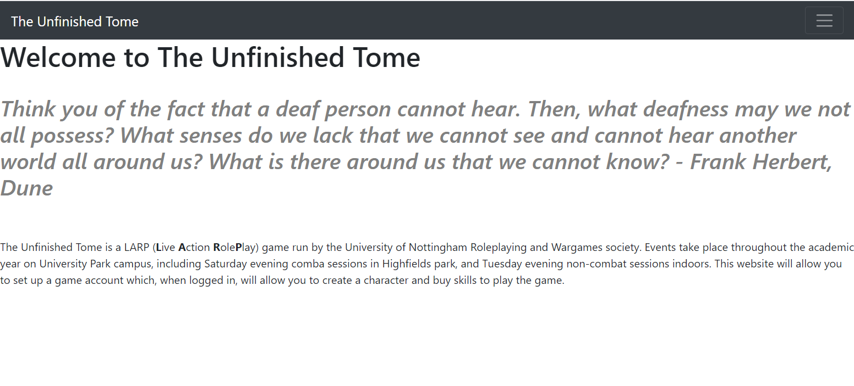
Final Home Page

Slide 15
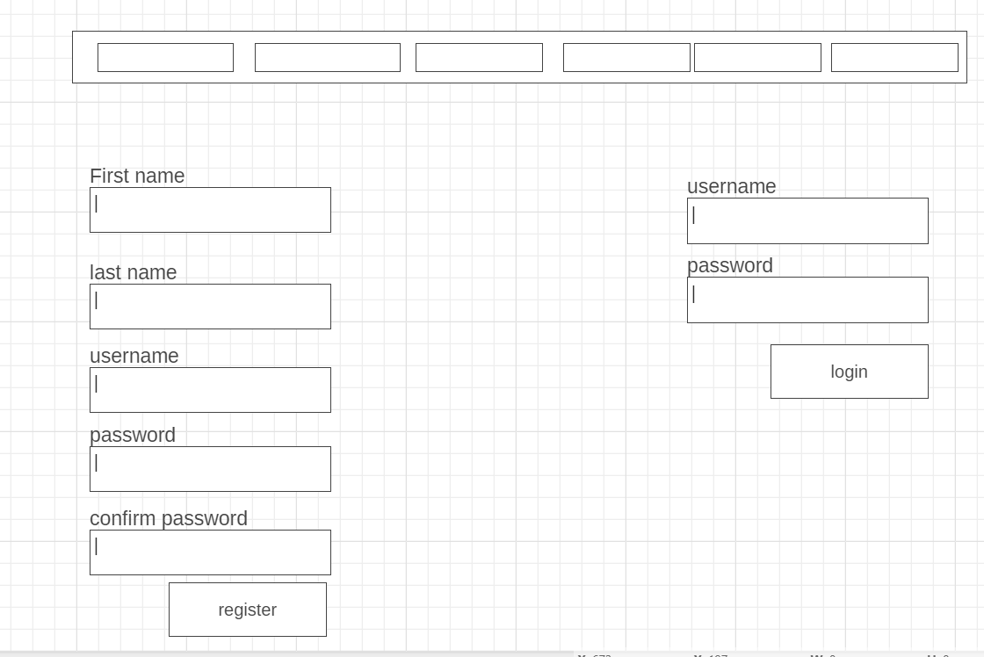
Wireframe diagrams – Login Page

Slide 16
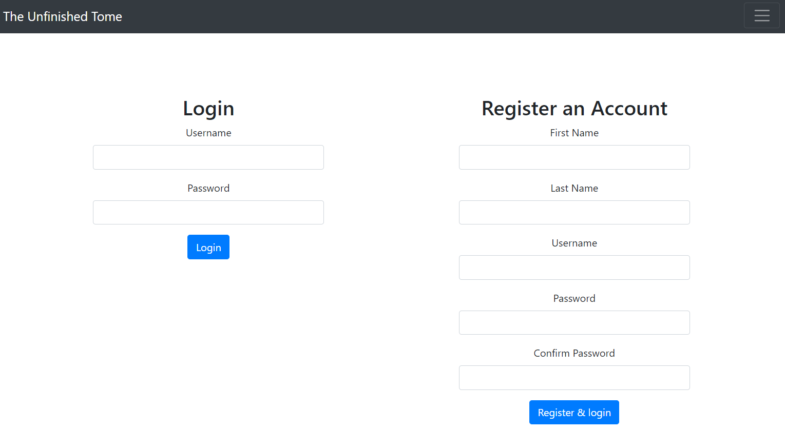
Final Login Page

Slide 17
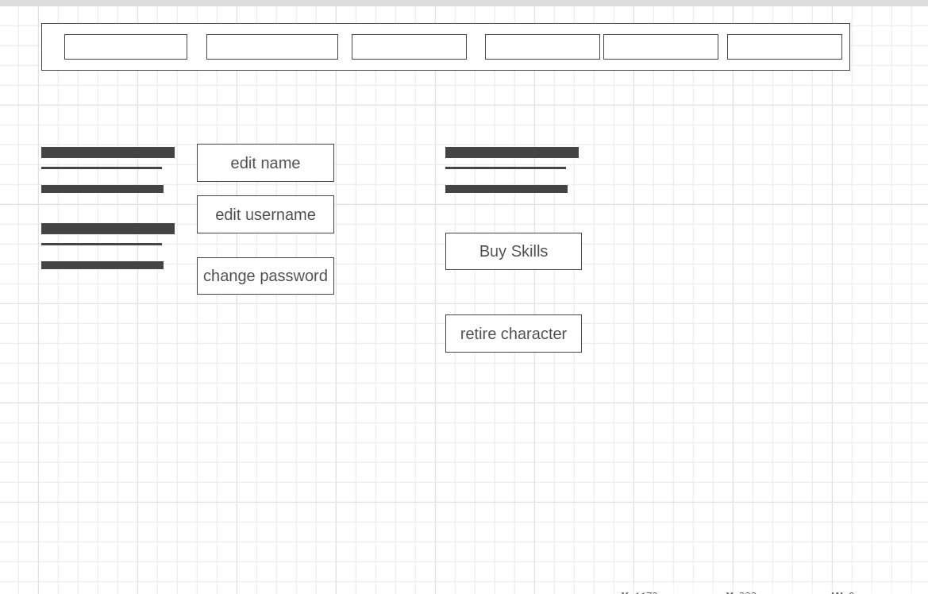
Wireframe diagrams – Account Page

Slide 18
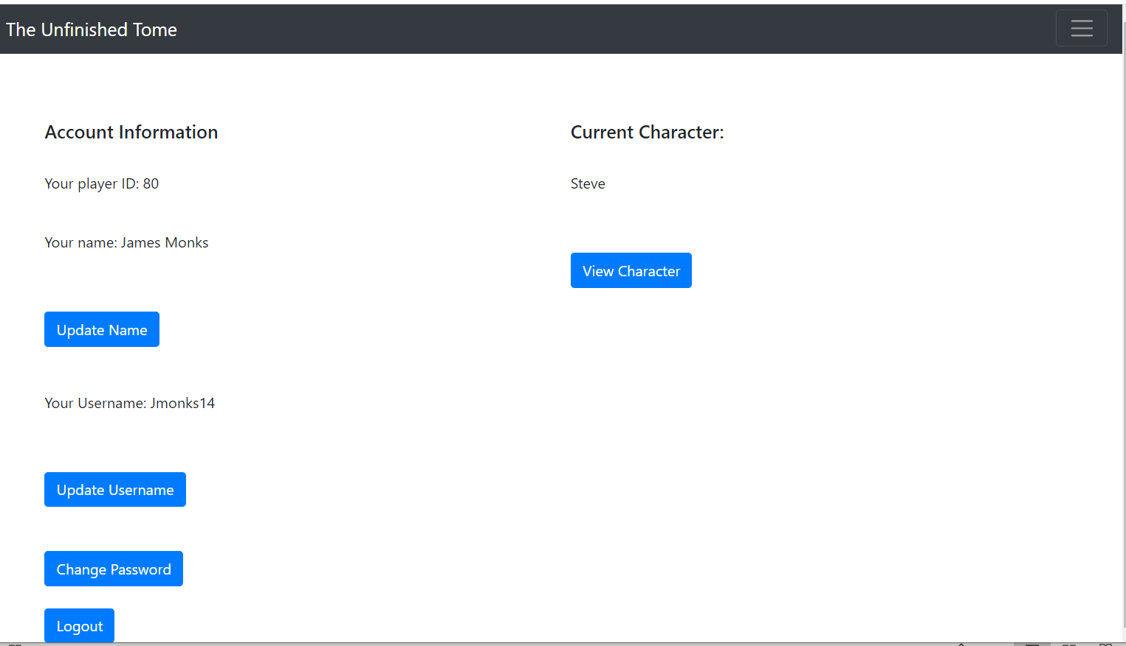
Final Account Page

Slide 19
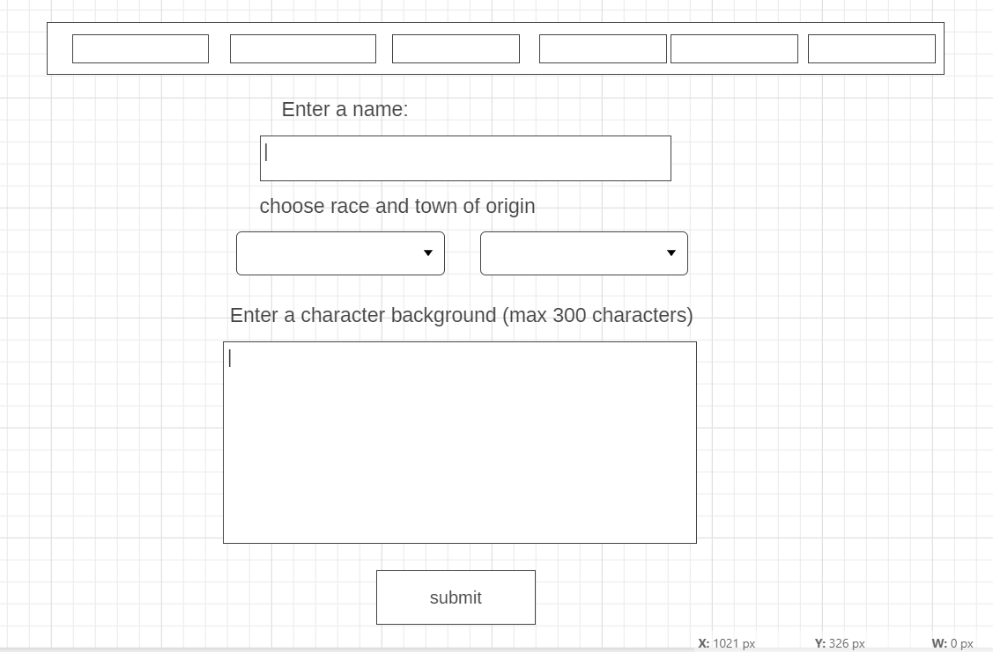
Wireframe diagrams – Character create Page

Slide 20
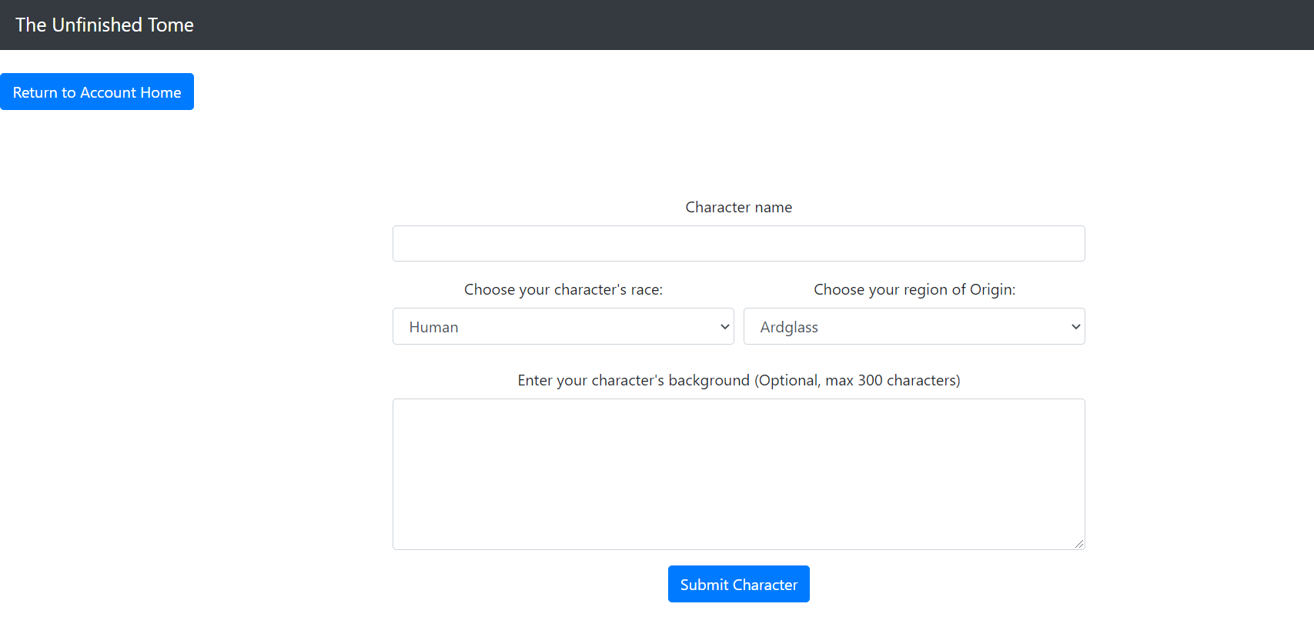
Final Character create page

Slide 21
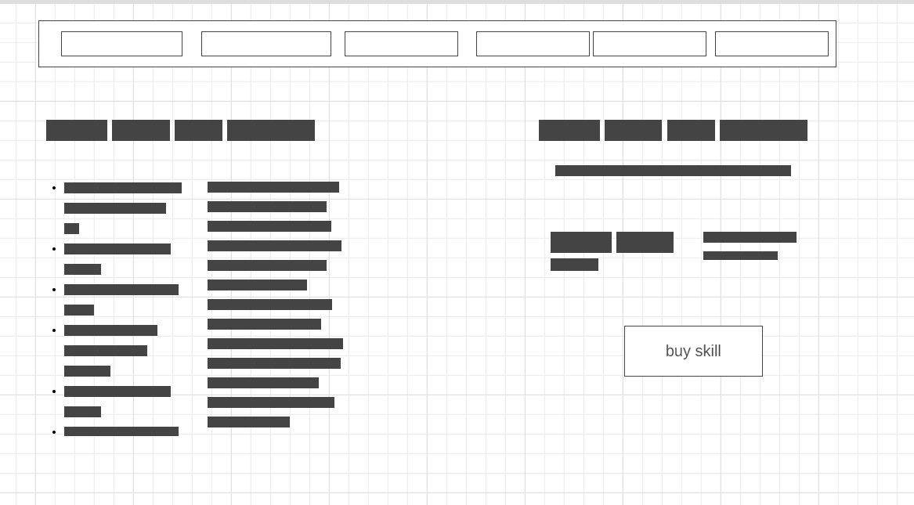
Wireframe diagrams – Character view Page

Slide 22
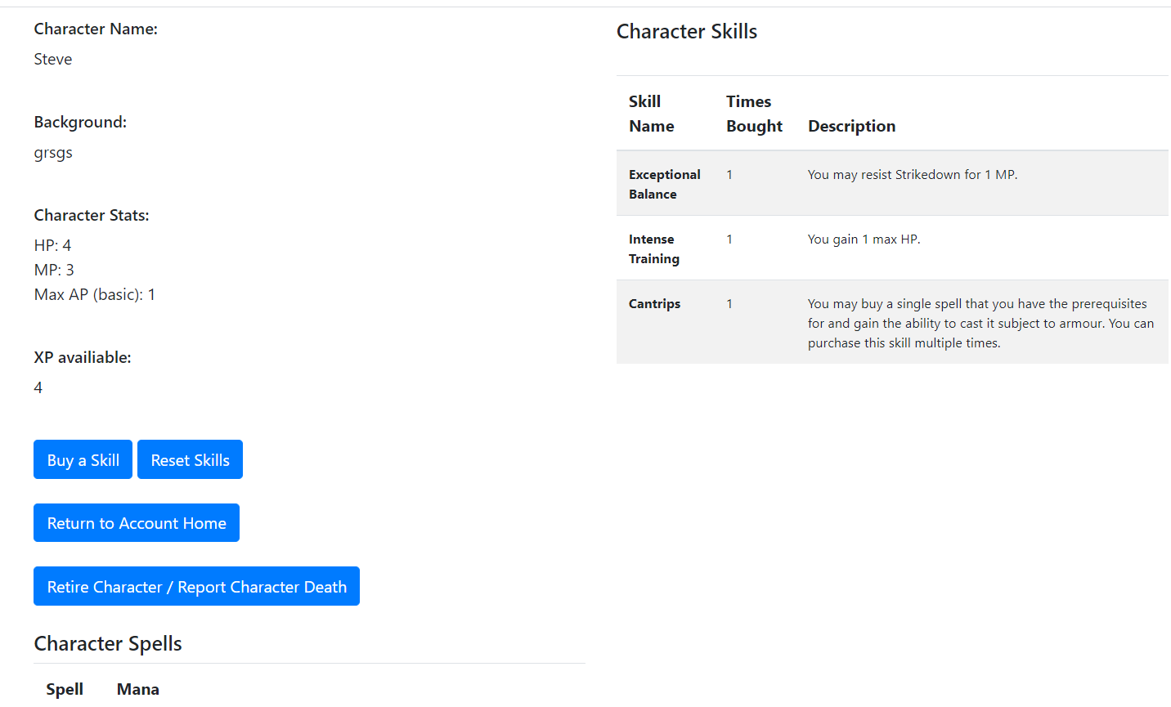
Final Character view page

Slide 23
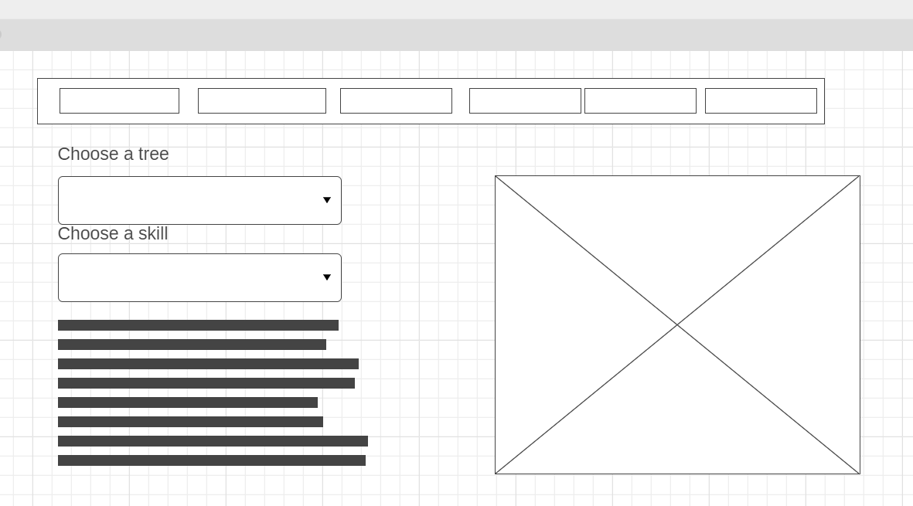
Wireframe diagrams – Buy skill Page

Slide 24
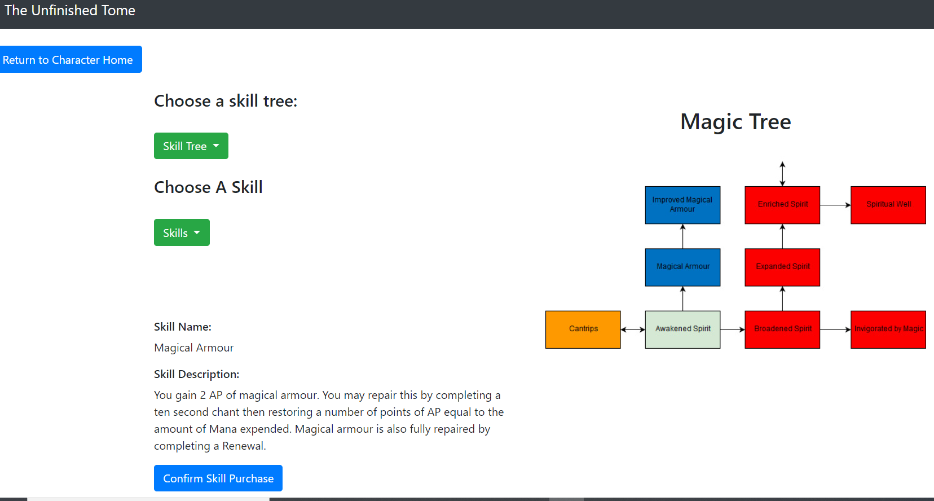
Final Skill buy page

Slide 25
Demo Time
file:///C:/Users/james/Documents/Git/Utomecharmaker/htmlpages/index.html

Slide 26
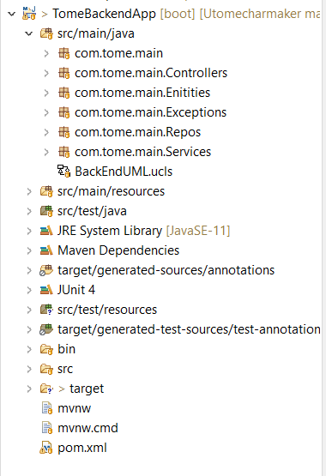
Backend design

Slide 27
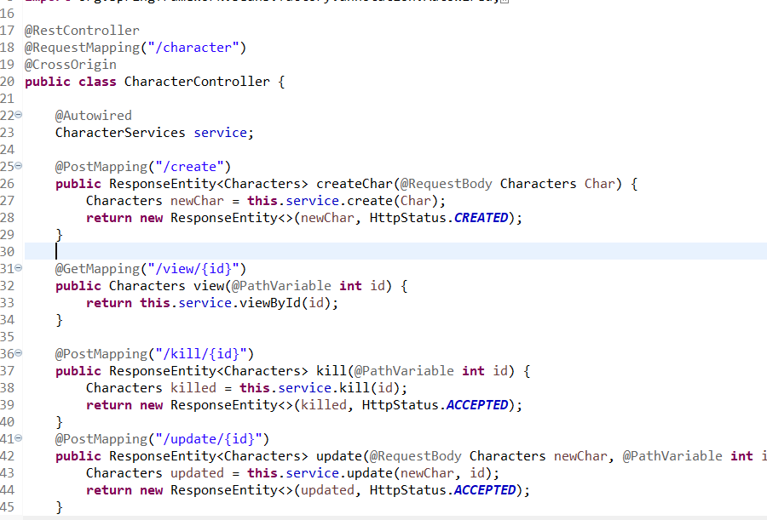
Backend Code

Slide 28
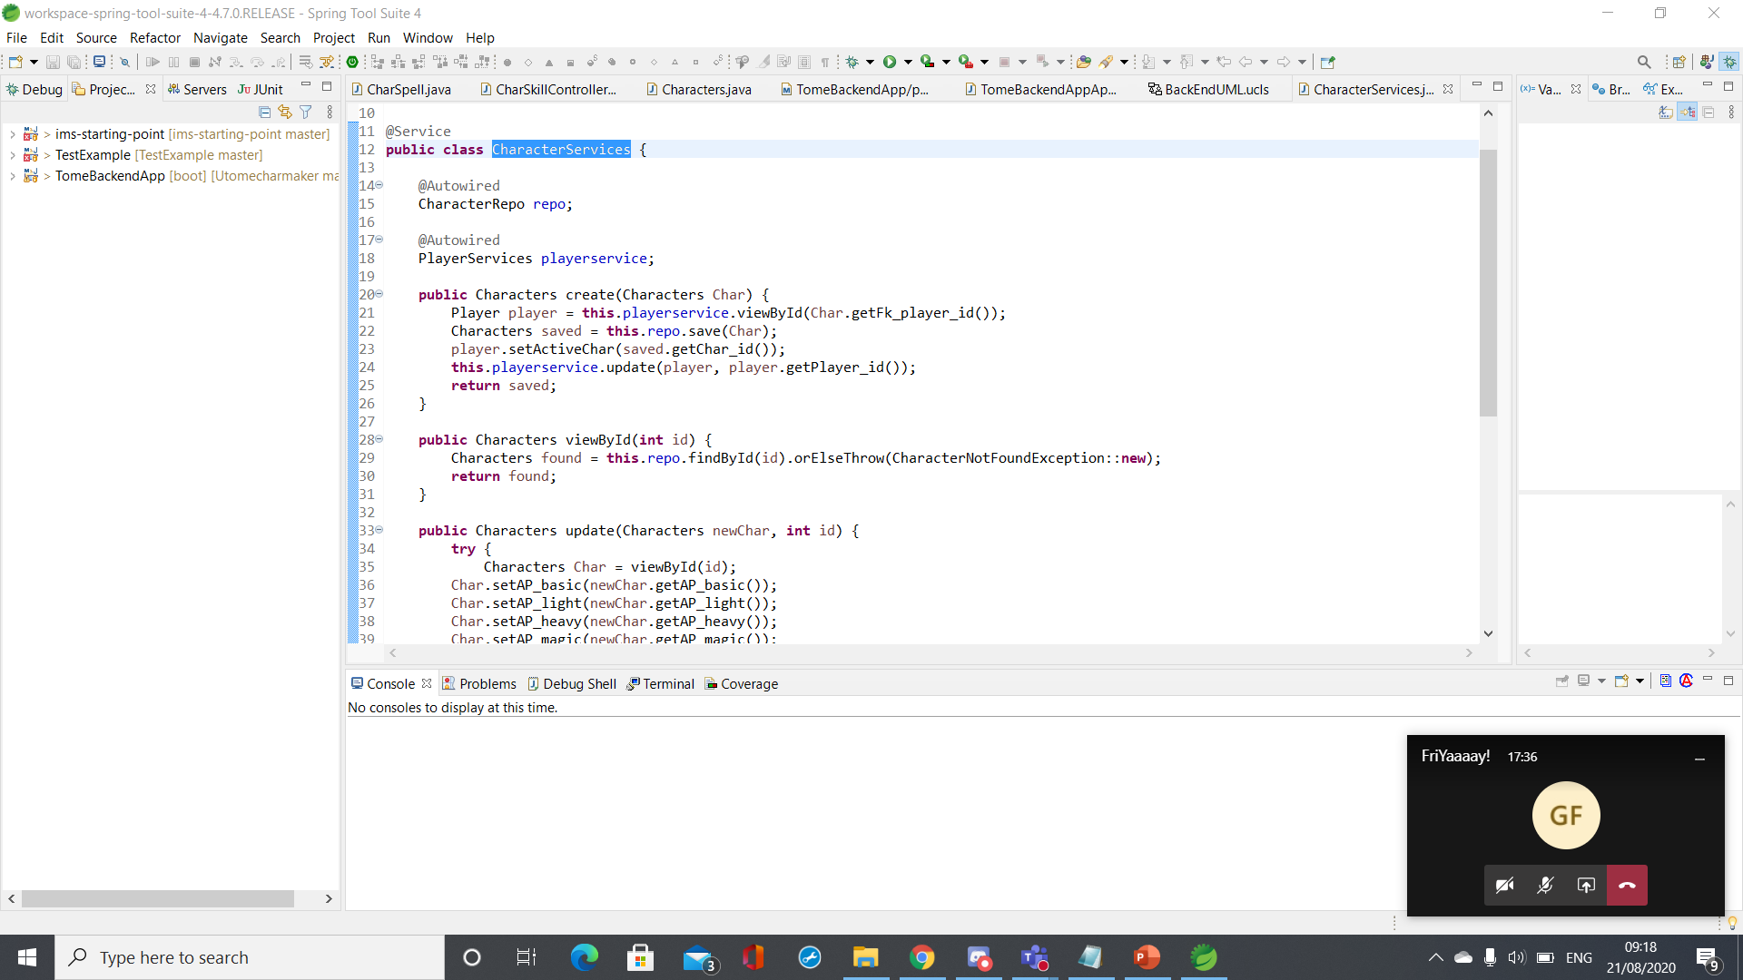
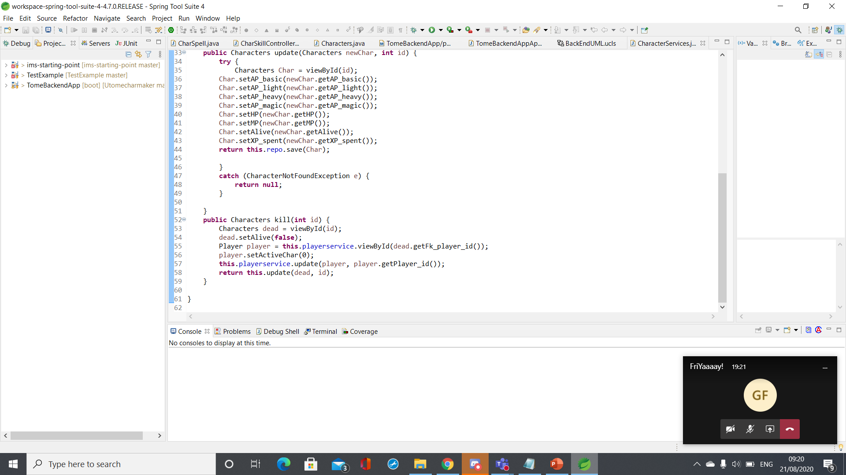
Backend Code

Slide 29
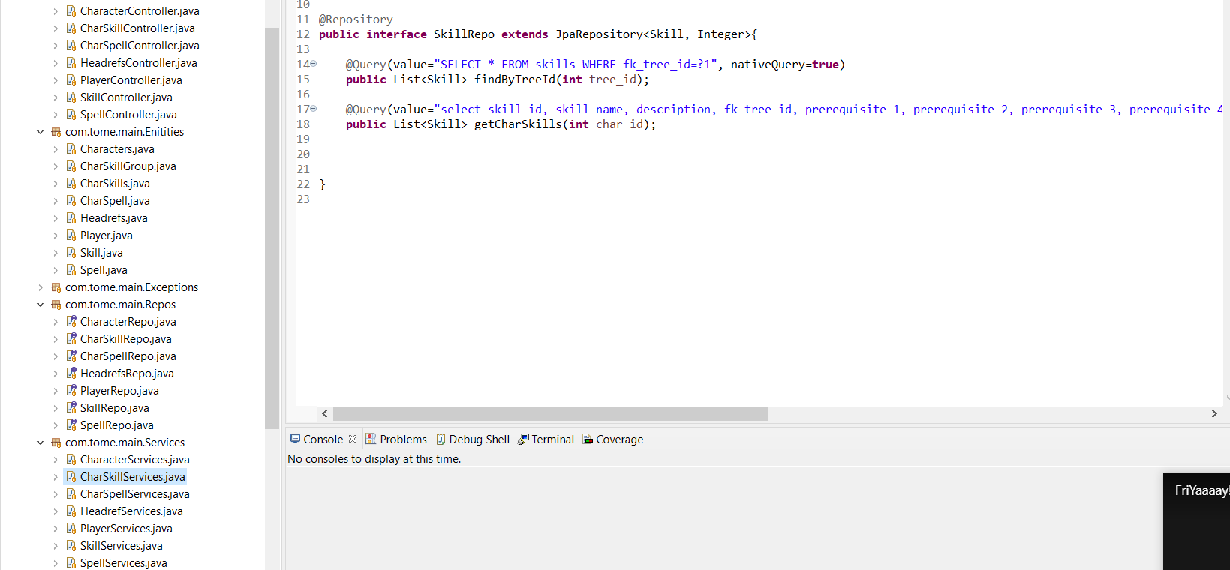
Backend classes

Slide 30
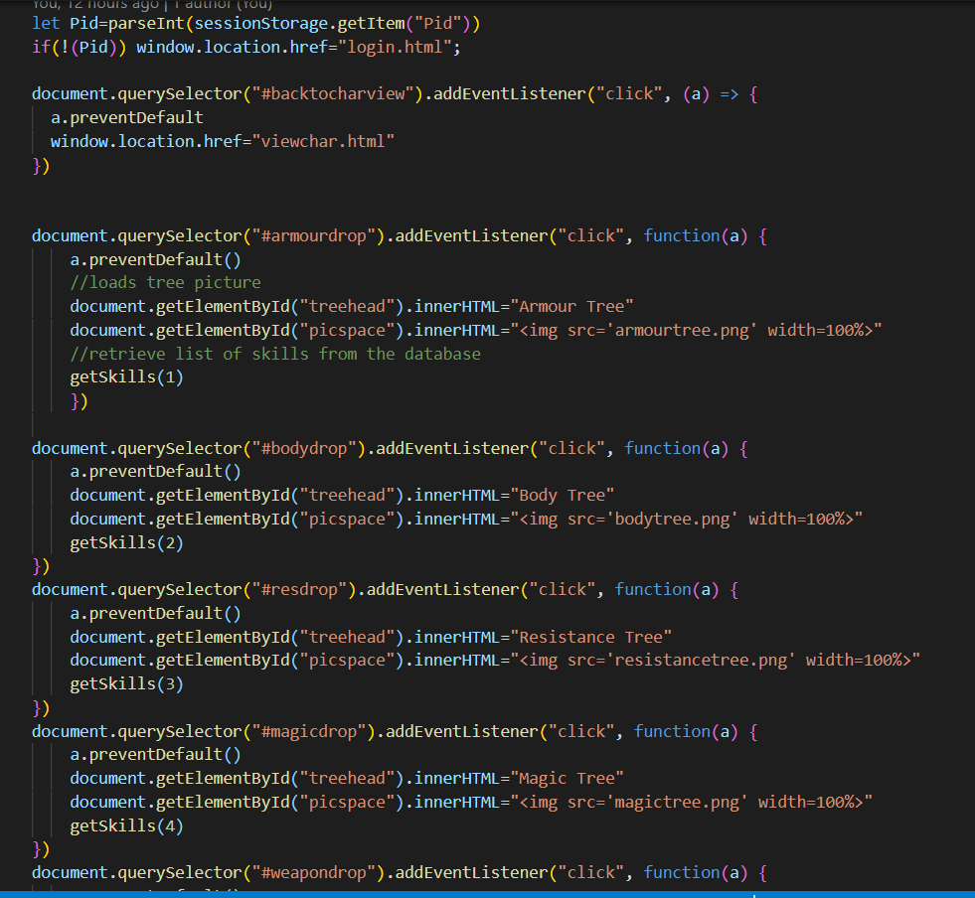
Buy skill logic

Slide 31
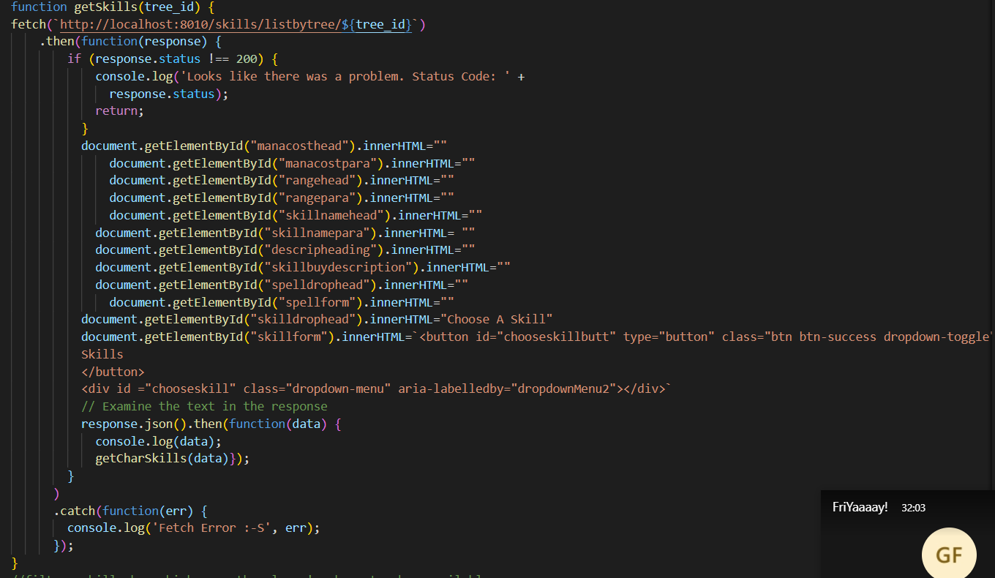
Buy skill logic

Slide 32
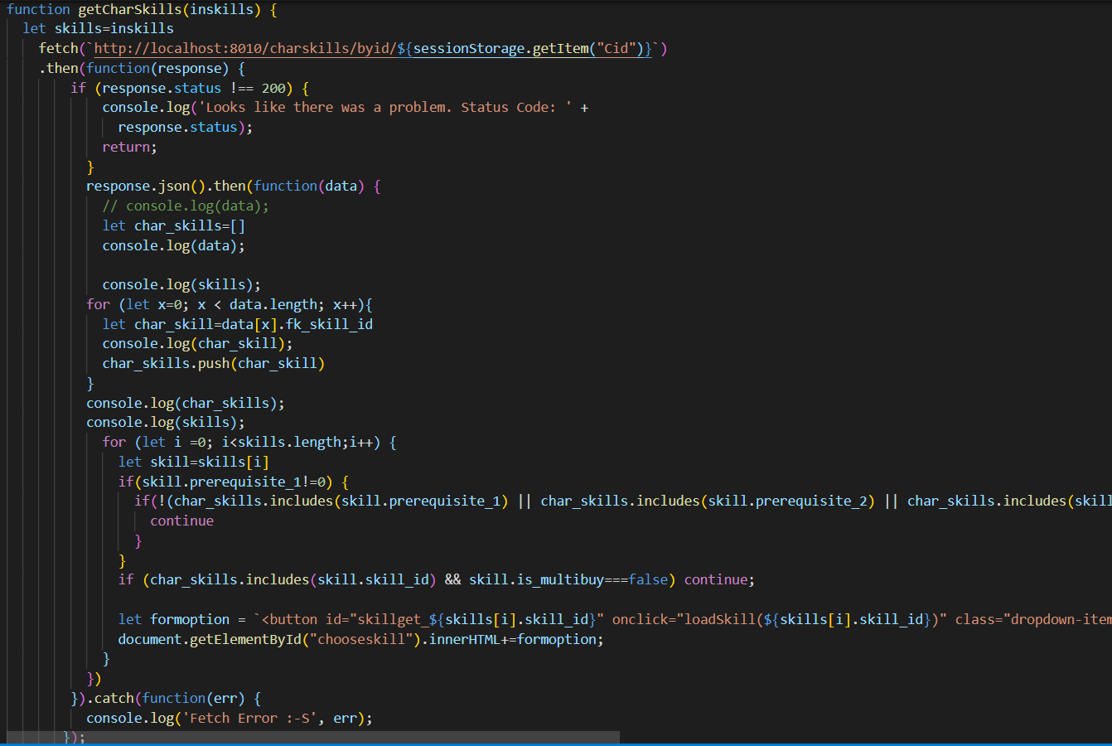
Buy skill logic

Slide 33
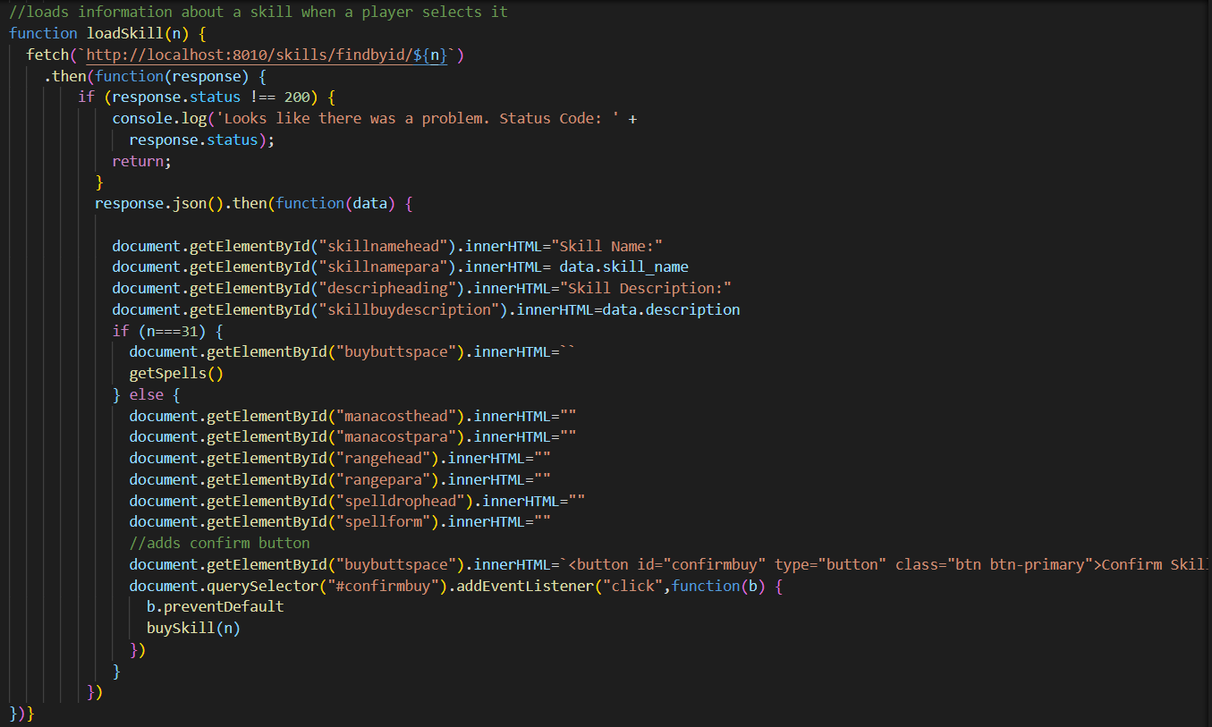
Buy skill logic

Slide 34
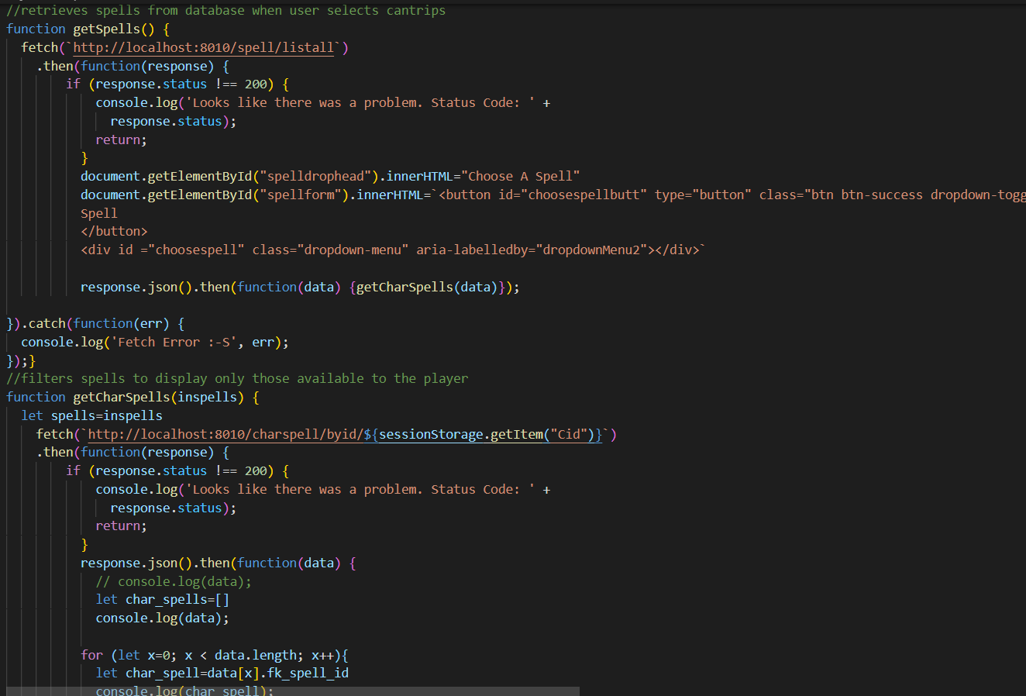
Buy skill logic

Slide 35
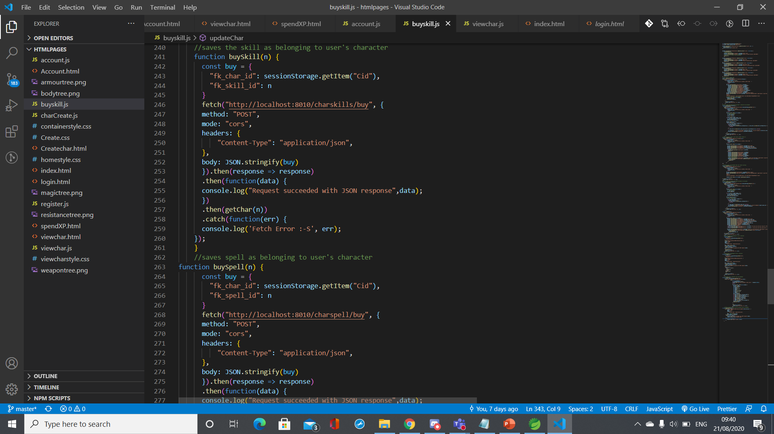
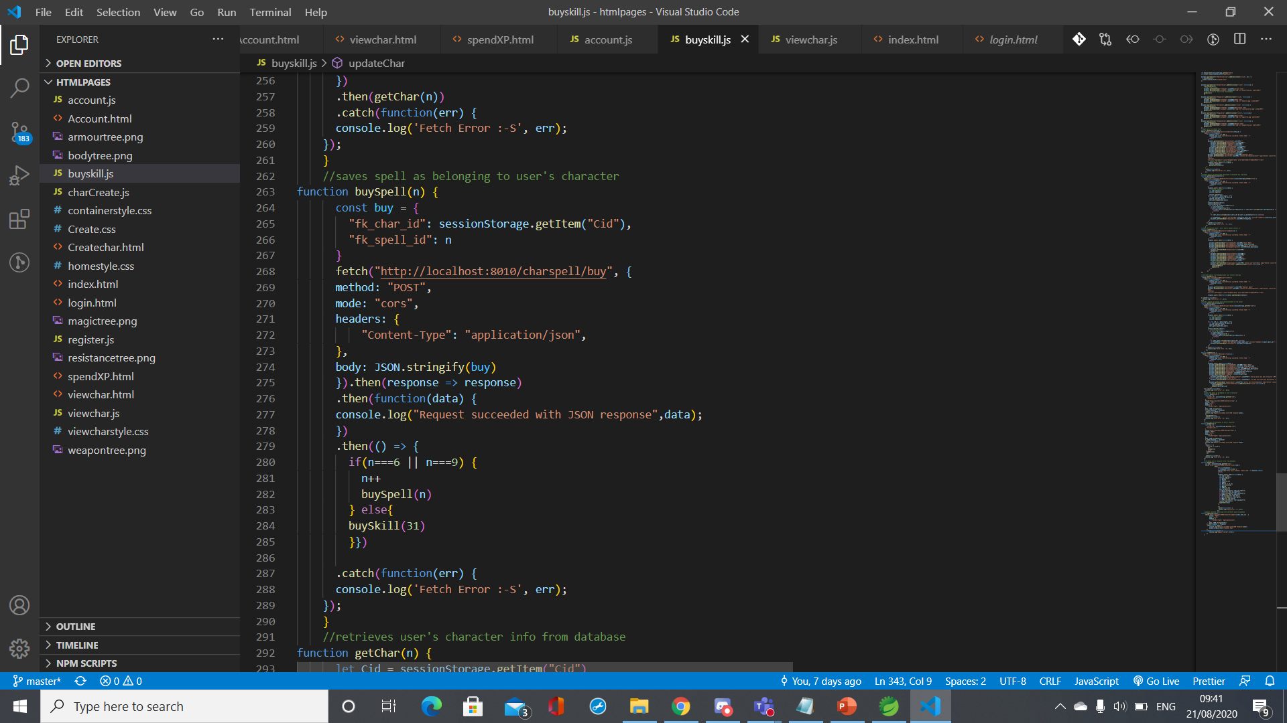
Buy skill logic

Slide 36
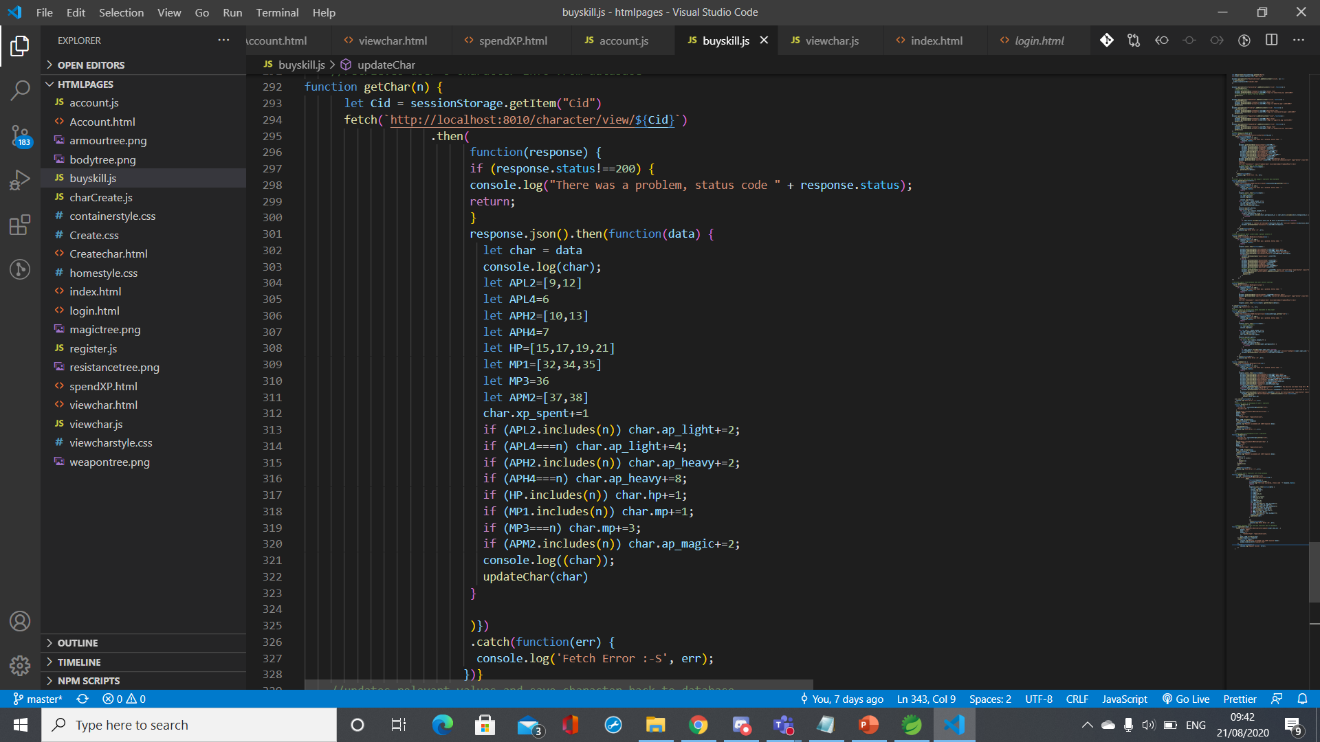
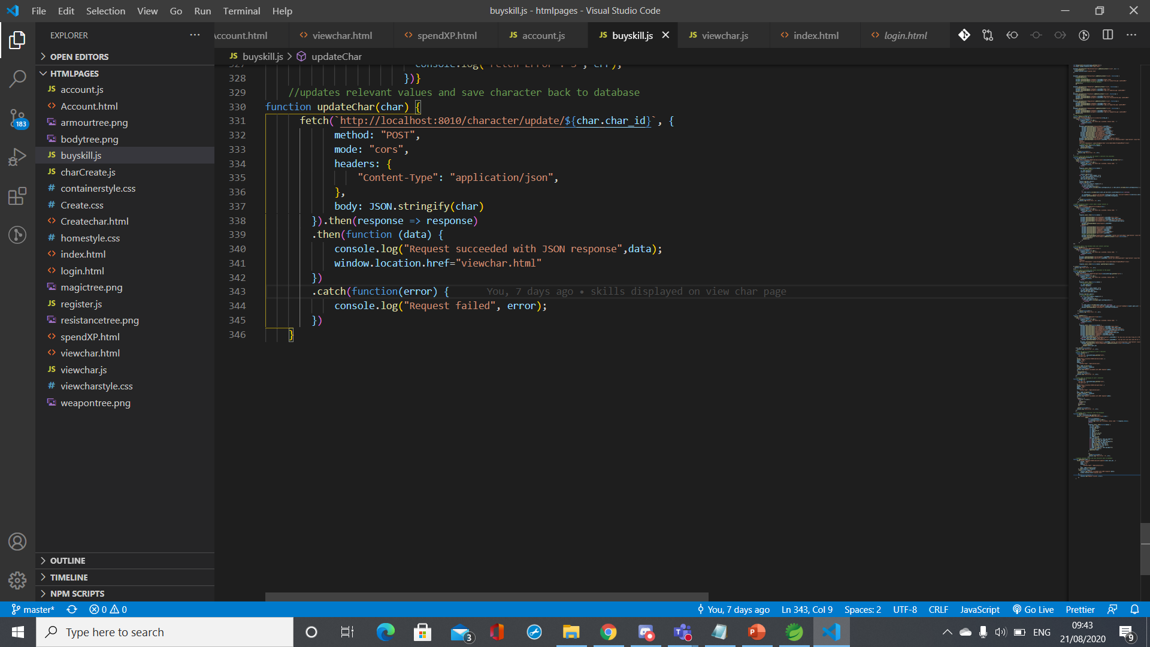
Buy skill logic

Slide 37
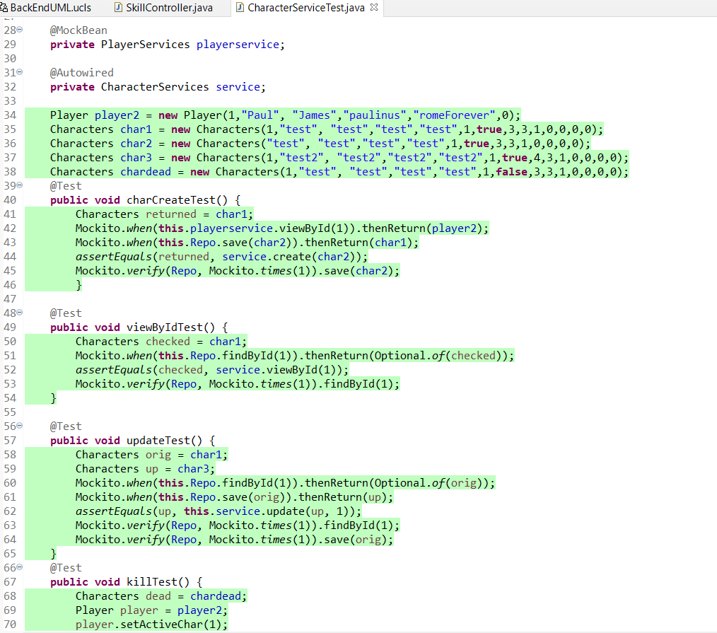
Unit testing

Slide 38
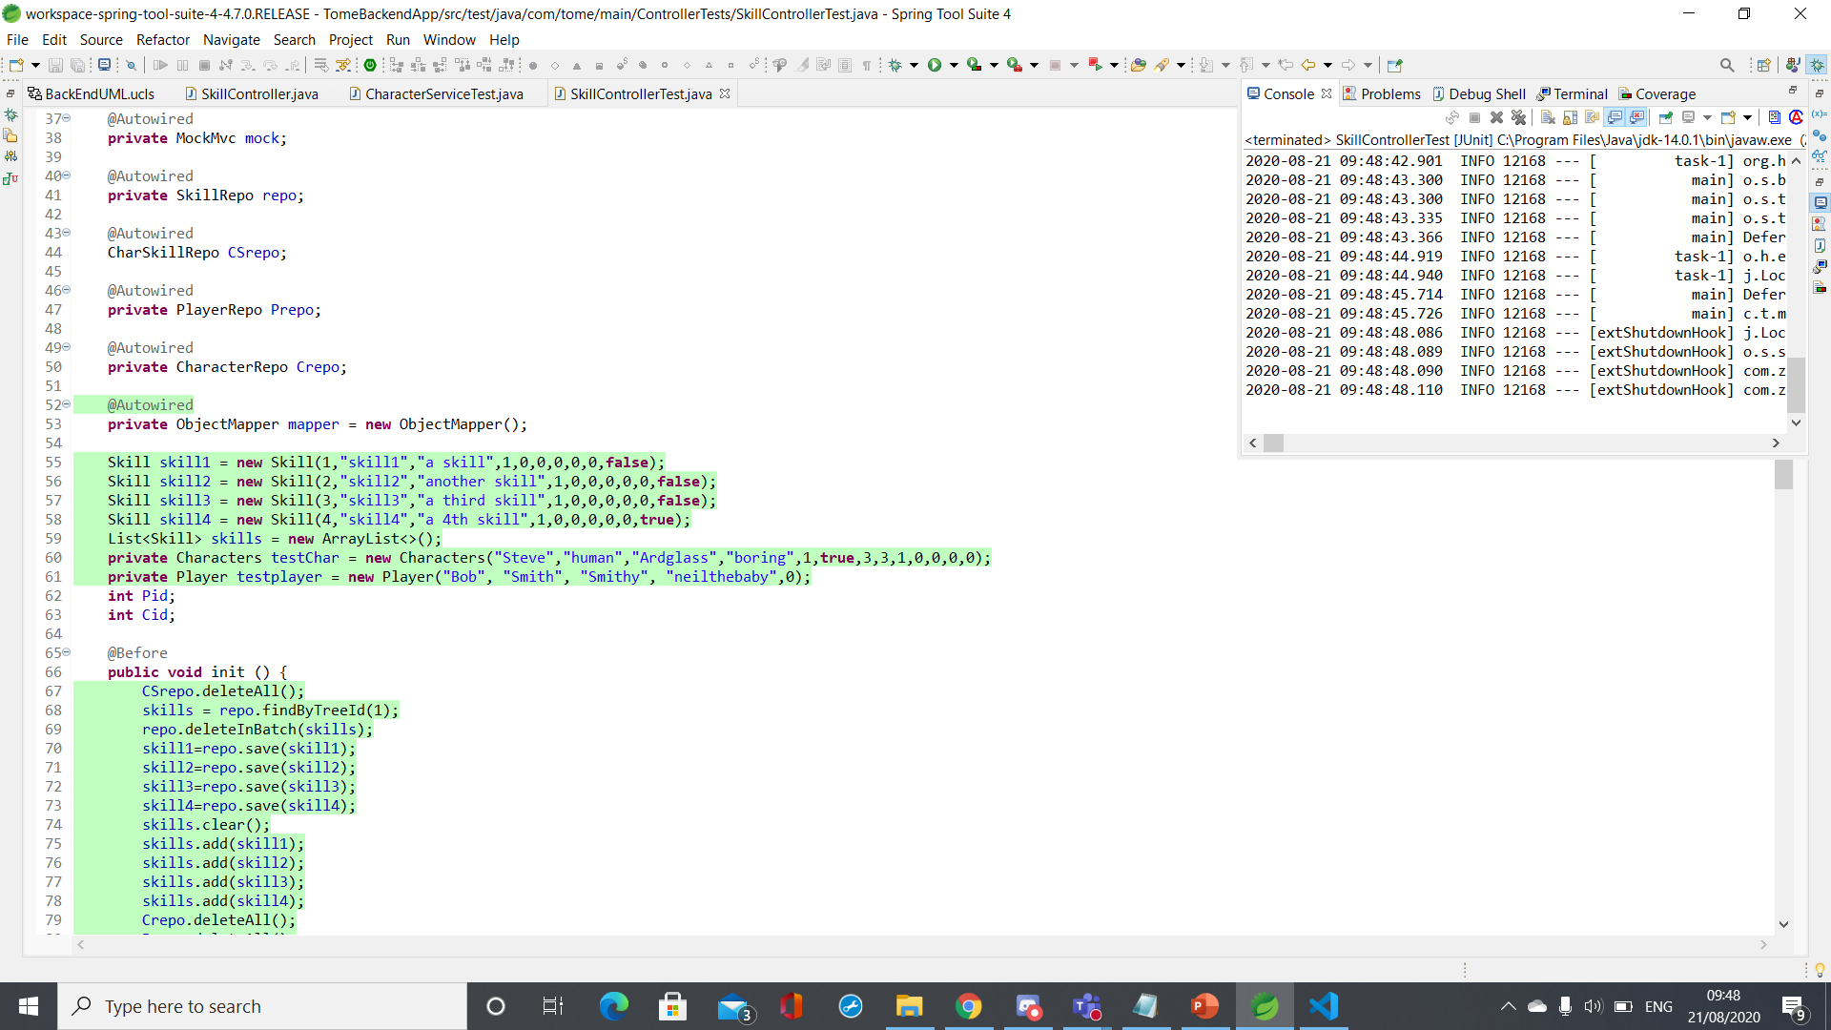
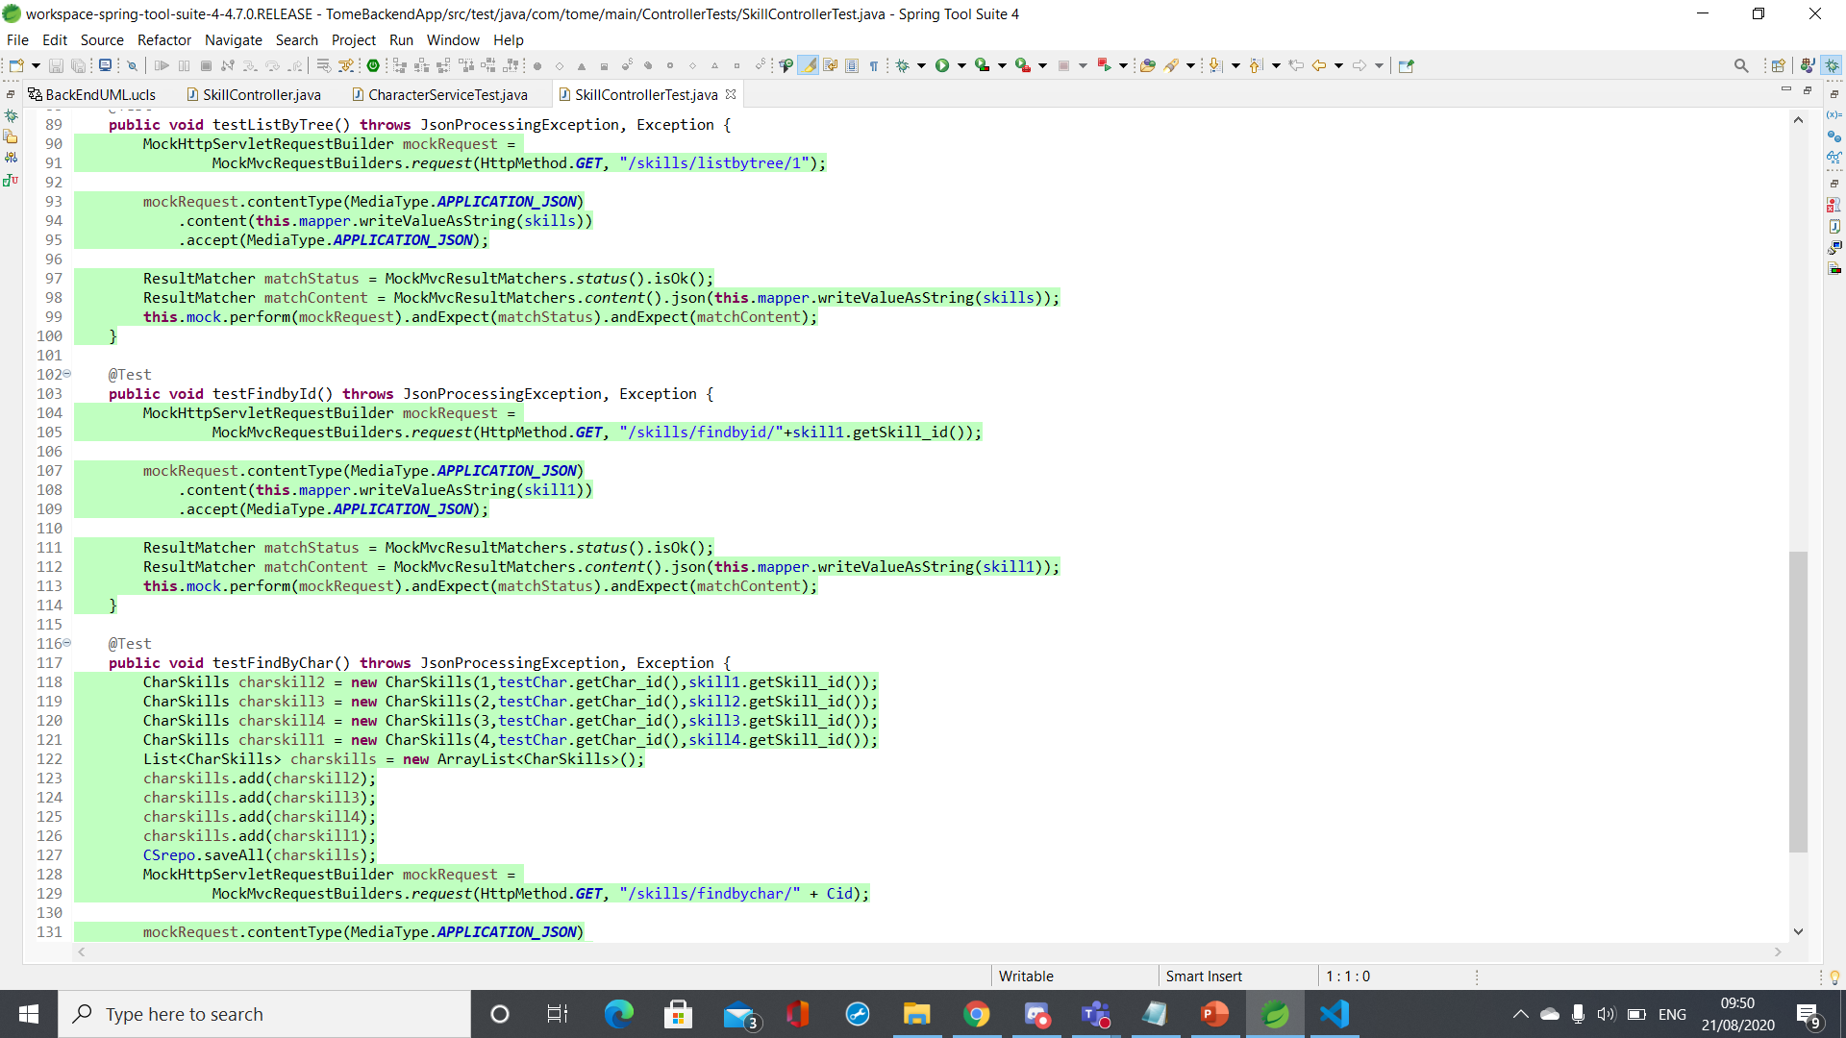
Unit Testing

Slide 39
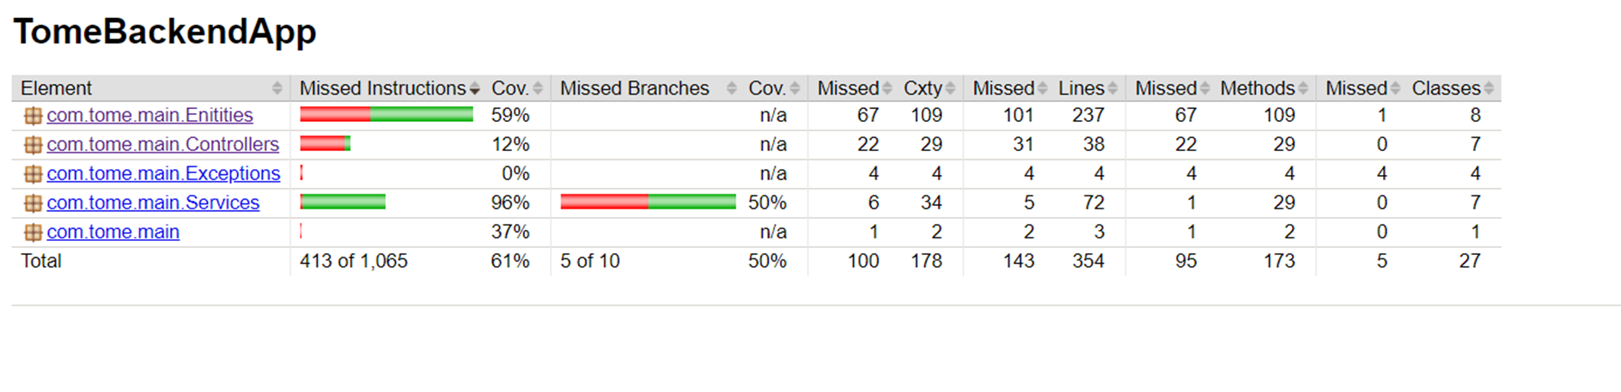
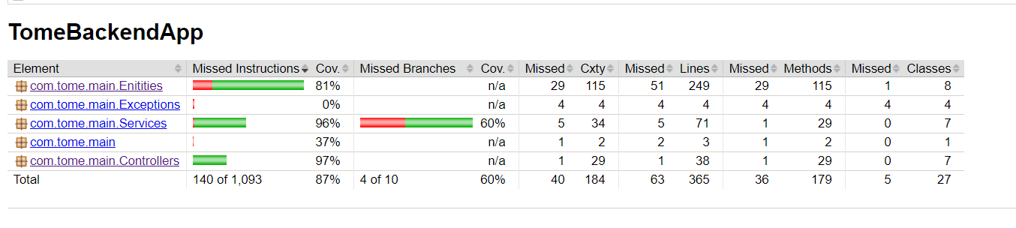
Surefire reports

Slide 40
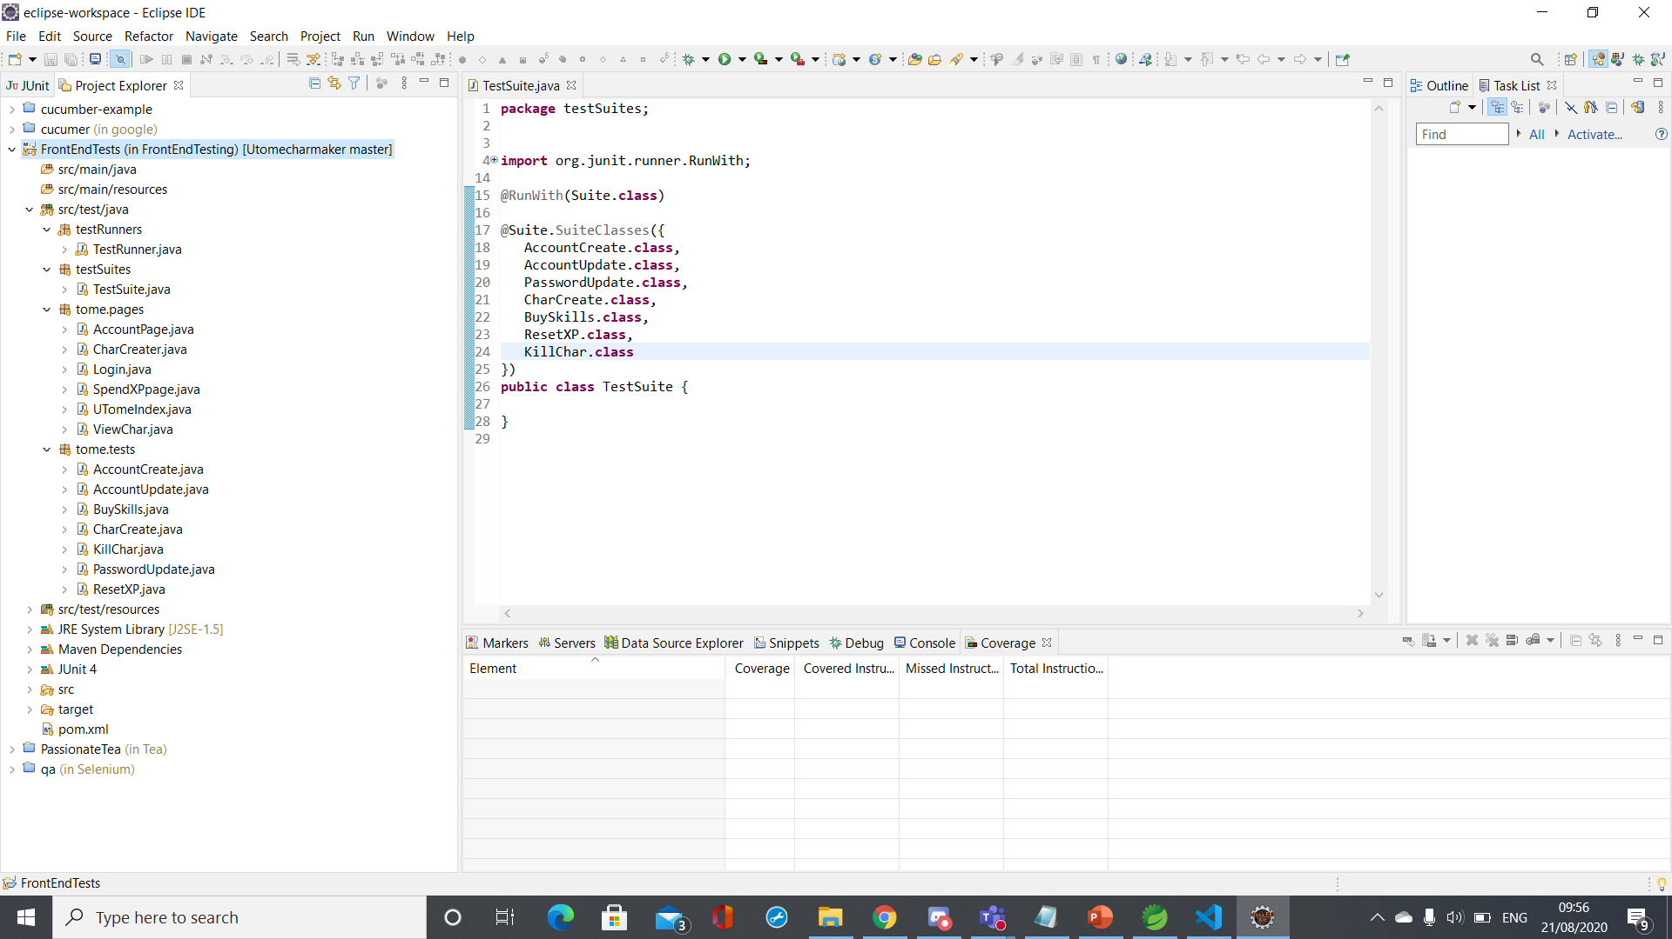
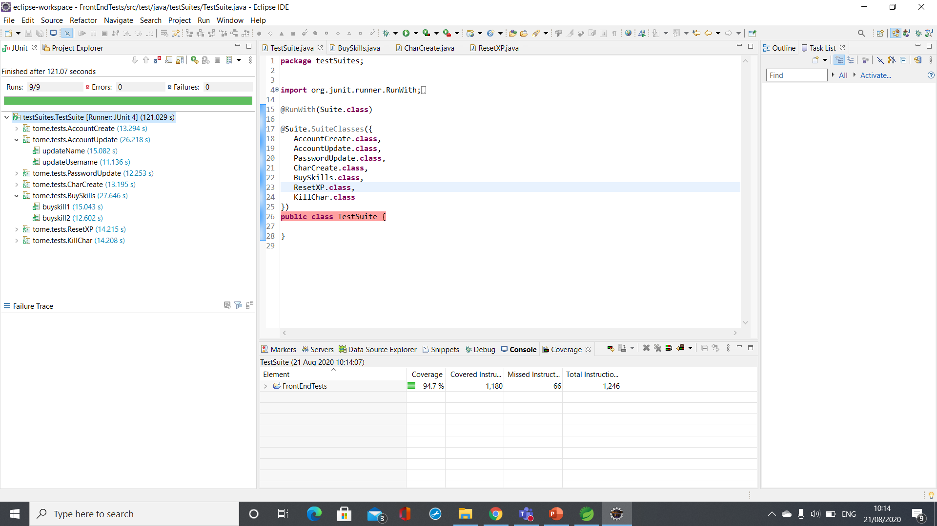
Integration testing

Slide 41
Conclusions
A web application was developed which players can use to create characters for “The Unfinished Tome”.
The interface ensures that the only character skills available to buy are those that they are eligible for according to the rules, and their character stats are updated appropriately.
The system has been thoroughly tested, achieving a high coverage.

Slide 42
Future Work
Implement secure login system
Add admin functionality
Tweak frontend design
Modify backend to use spring relationships
Add more pages to the website with information about the game

Slide 43
Acknowledgements
Vinesh Ghela
Alan Davis
Shafeeq Muhammed
The whole 20JuneSoftware1 cohort

